Slide 1

The Atomic Bomb
Libby Divers and Riley Rutigliano

Slide 2

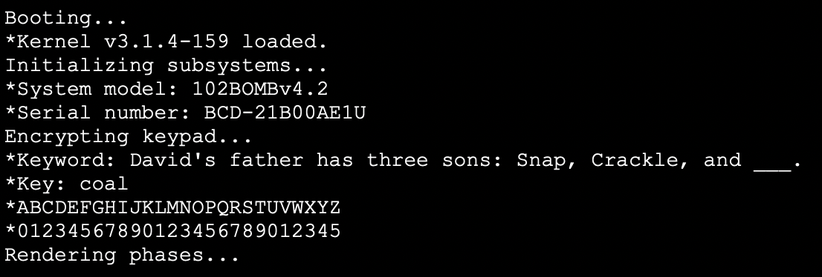
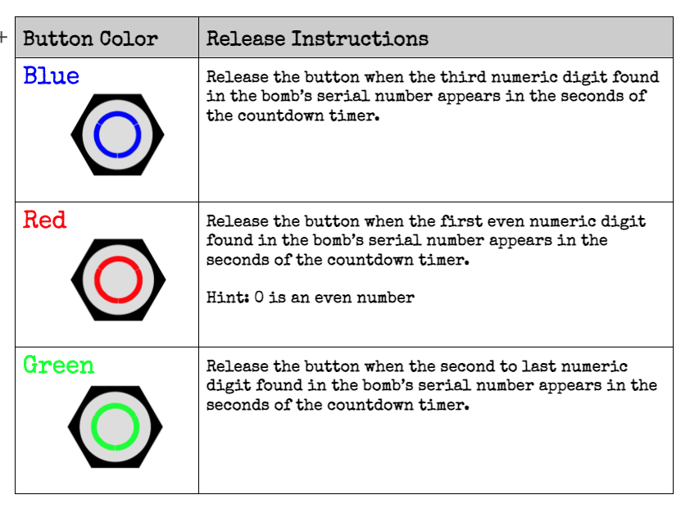
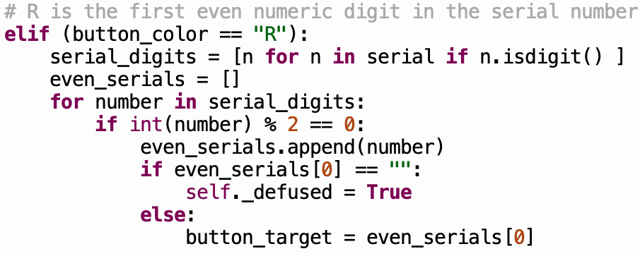
Button
Notes:
Red button = hold and release the button on the first even number in the serial number

Slide 3
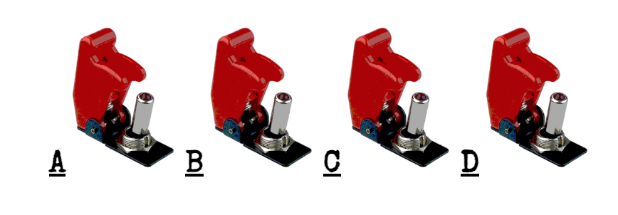
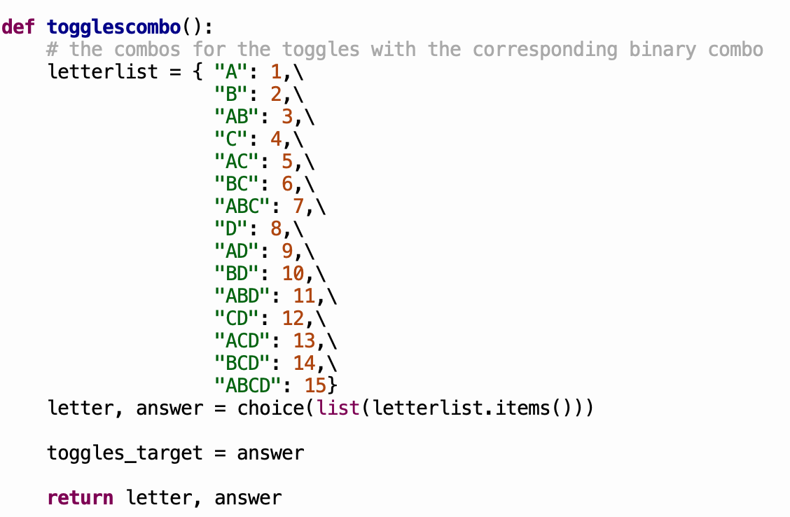
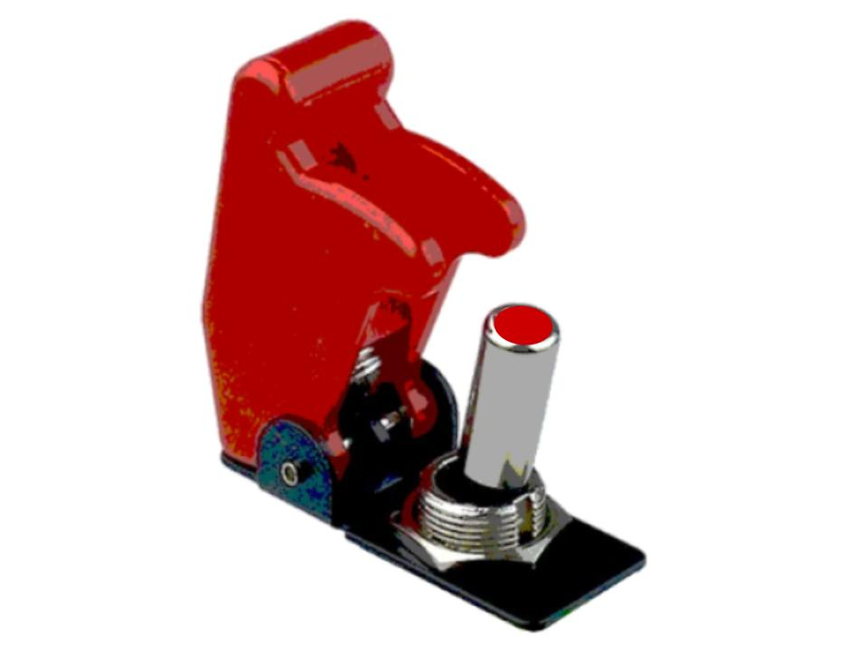
Toggles
Notes:
Hid the combo in the beginning of the serial number to identify which toggles should be switched up

Slide 4
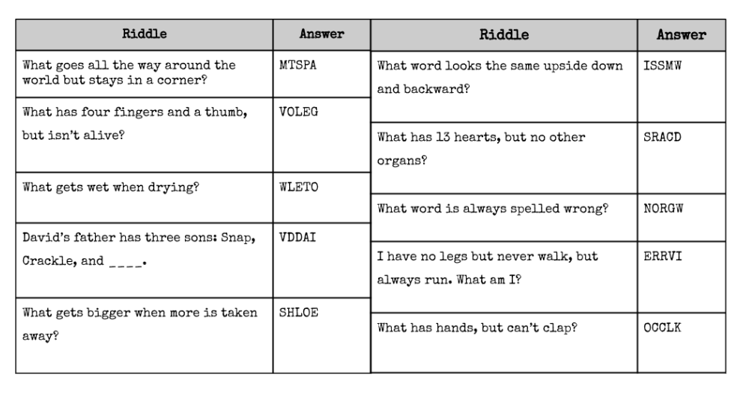
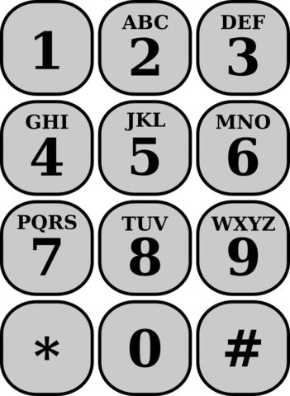
Keypad
Notes:
Gave a riddle on the screen of the bomb and on the manual the answer was scrambled - they had the option to unscramble the riddle or try to guess the answer

Slide 5
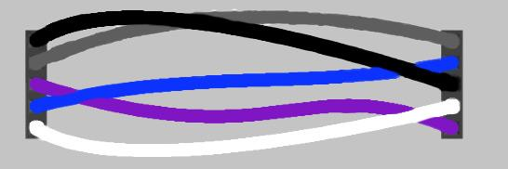
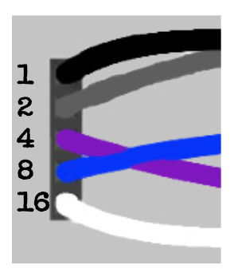
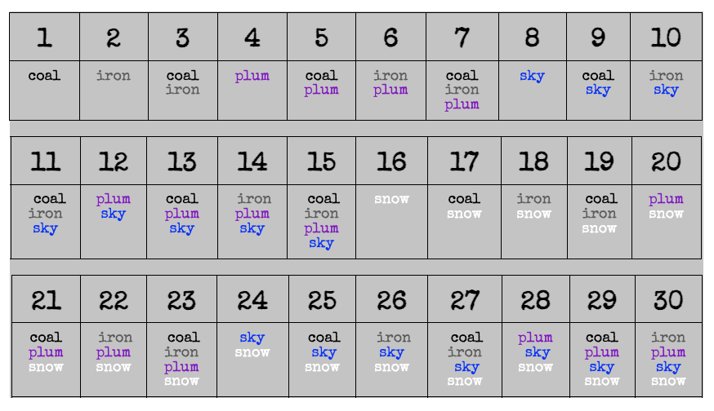
Wires
Notes:
Key words would be displayed on the screen (coal, iron, plum, sky, and/or snow) - the key word(s) would indicate which wires to keep plugged in

Slide 6



Unique Features
Defused
Strike
Winner
Loser
Notes:
Everytime you defuse a phase - there was a noise | every time you got a strike - there was a noise | at the end - if you won there was an image with a noise - if you lost there was an image with a noise

Slide 7



Improvements
Notes:
Add a timer ticking in the background throughout the whole bomb | add another color for the button | Defused picture when you defuse a phase

Slide 8
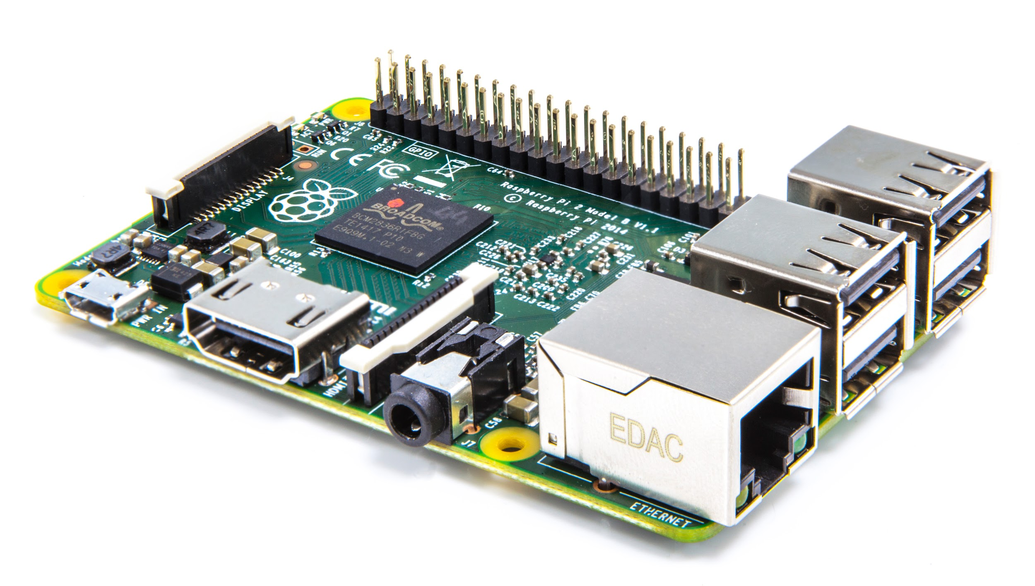
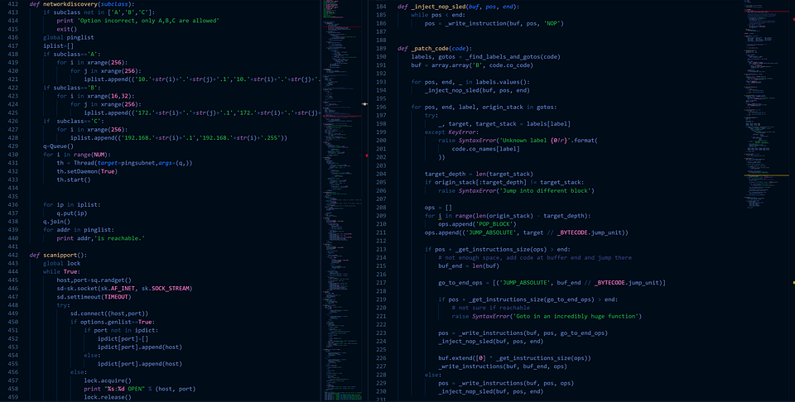
Takeaways
Notes:
Learned more about raspberry pi | learned to read and understand challenging code

